Slide 1
Beers & Breweries EDA
Matt Sherga & Rudranil Mitra

Slide 2
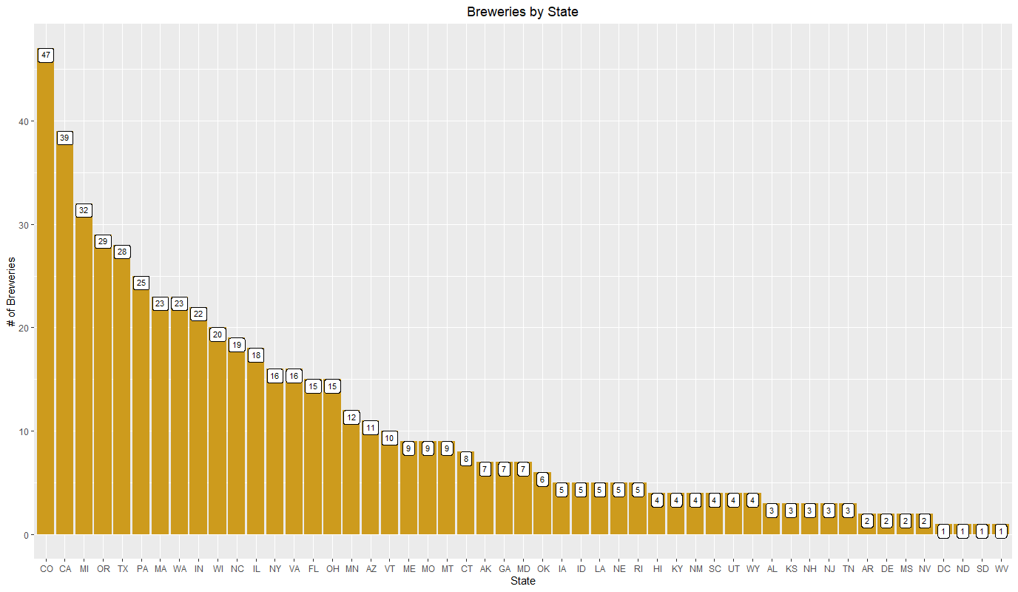
How many breweries are in each state?
Top 5 most breweries per state (in order):
Colorado, California, Michigan, Oregon and Texas

Slide 3
Was there any missing data?
ABV had 62 missing values
IBU had 1005 missing values
Style of beer had 5 missing values
Initial approach: Web Scraping. Abandoned due to programming limitations.
Resolution: Imputation of % ABV and IBU medians per style.
Two exceptions to the imputation approach:
1. Missing Style values
2. Missing IBU values after imputation
Notes:
Our initial idea was to scrape the web to find the missing values for ABV & IBU. However we encountered quite a few challenges in extracting the data from the internet due to inconsistencies in HTML formatting across different websites. Our final approach was to calculate the median values of ABV and IBU per style and impute them into the respective missing values. Before we did that, the missing Style values had to be addressed.
Upon examining the five rows of missing Style of beer, manual intervention was required.
- Belonging to Oskar Blues, "CROWLER" is not a beer, it's just a container. And "Can’d AID foundation" is not a beer. It's a charitable foundation.
From Cedar Creek Brewery, “Special Release” just refers to a series of beers.
Added Styles to Oktoberfest from Freetail Brewing Co. and to Kilt Lifter from Four Peaks Brewing Co.

Slide 4
Was there any missing data? (cont.)
Exception 1 – The five missing Styles:
Removed: “CROWLER” & “Can’d AID Foundation” are NOT beers. “Special Release” is a series of beers.
Manual additions: “Oktoberfest” - Freetail Brewing Co.
“Kilt Lifter” - Four Peaks Brewing Co.
(Sourced data from untappd.com)
Exception 2 – 52 missing IBU values:
Manual additions: “Golden Frau” – Thunderhead Brewing
“Southern Cross” – Hawai’i Nui
“Weiss Weiss Baby” – Figueroa Mountain Brewing
(Sourced data from untappd.com)
Remaining beers: styles do not have IBU ratings due to lack of hops. One beer, “Scotty K NA” – Uncommon Brewers, no available data found.
Notes:
Our initial idea was to scrape the web to find the missing values for ABV & IBU. However we encountered quite a few challenges in extracting the data from the internet due to inconsistencies in HTML formatting across different websites. Our final approach was to calculate the median values of ABV and IBU per style and impute them into the respective missing values. Before we did that, the missing Style values had to be addressed.
Upon examining the five rows of missing Style of beer, manual intervention was required.
- Belonging to Oskar Blues, "CROWLER" is not a beer, it's just a container. And "Can’d AID foundation" is not a beer. It's a charitable foundation.
From Cedar Creek Brewery, “Special Release” just refers to a series of beers.
Added Styles to Oktoberfest from Freetail Brewing Co. and to Kilt Lifter from Four Peaks Brewing Co.

Slide 5
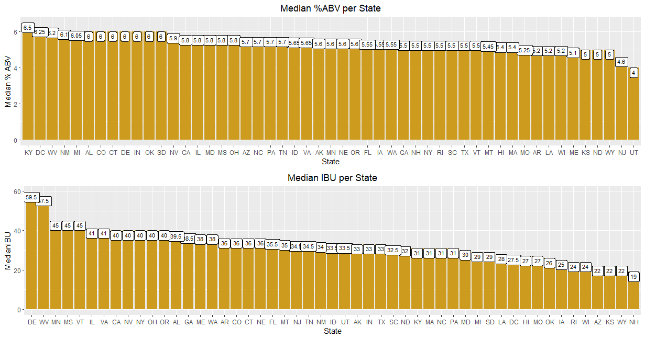
Median % ABV / IBU per State
Top 5 Median % ABV: Kentucky, DC, West Virginia, New Mexico, Michigan Top 5 Median IBU: Delaware, West Virginia, Minnesota, Mississippi, Vermont

Slide 6
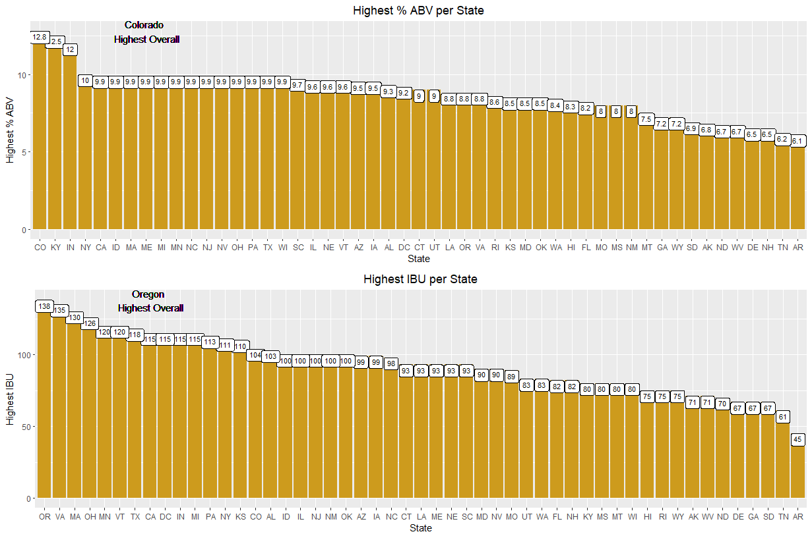
Highest % ABV/IBU

Slide 7
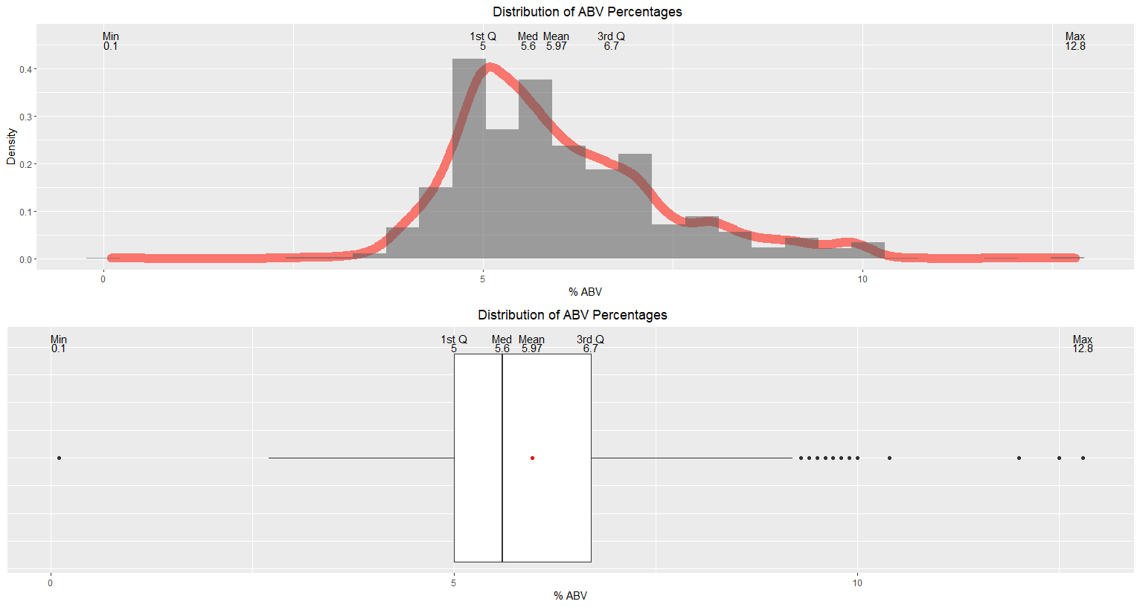
Summary of % ABV
Right-skewed with some outliers. 5 - 6% most popular ABV.
Notes:
Also ran the summary data with the single NA beer removed that has a .1% ABV, but the only statistic that changed was the minimum. So the data point was left in.

Slide 8
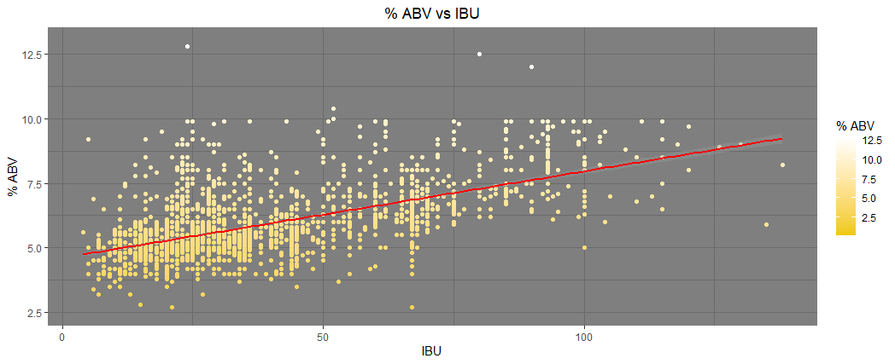
% ABV Compared to IBU
There is an increasing linear trend showing that as breweries are making higher % ABV beers, IBU is also higher.
Values are not interdependent:
% ABV is determined by yeast amount and time to ferment
IBU is a result of quantity/type of hops

Slide 9
Citations
The Untappd Team (n.d.). OktoberFiesta - Freetail Brewing Co. Retrieved from https://untappd.com/b/freetail-brewing-co-oktoberfiesta/79567
The Untappd Team (n.d.). Kilt Lifter - Four Peaks Brewing Company. Retrieved from https://untappd.com/b/four-peaks-brewing-company- kilt-lifter/4055
The Untappd Team (n.d.). Golden Frau - Thunderhead Brewing. Retrieved from https://untappd.com/b/thunderhead-brewing-golden-frau/38392
The Untappd Team (n.d.). Southern Cross Belgian Double Red Ale - Hawai’i Nui Brewing. Retrieved from https://untappd.com/b/hawai-i-nui- brewing-southern-cross-belgian-double-red-ale/29698
The Untappd Team (n.d.). Weiss Weiss Baby - Figueroa Mountain Brewing Co. Retrieved from https://untappd.com/b/figueroa-mountain-brewing- co-weiss-weiss-baby/1043342

